Slide 1


Unit 6.4 Introduction to means of access for IoT networks

Slide 2

Unit Goal
This unit aims to introduce the means of access for IoT networks.
The students will have only an overview of IoT network technologies.

Slide 3
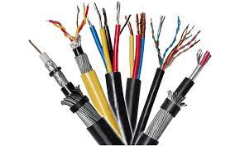
Network Foundations

Slide 4
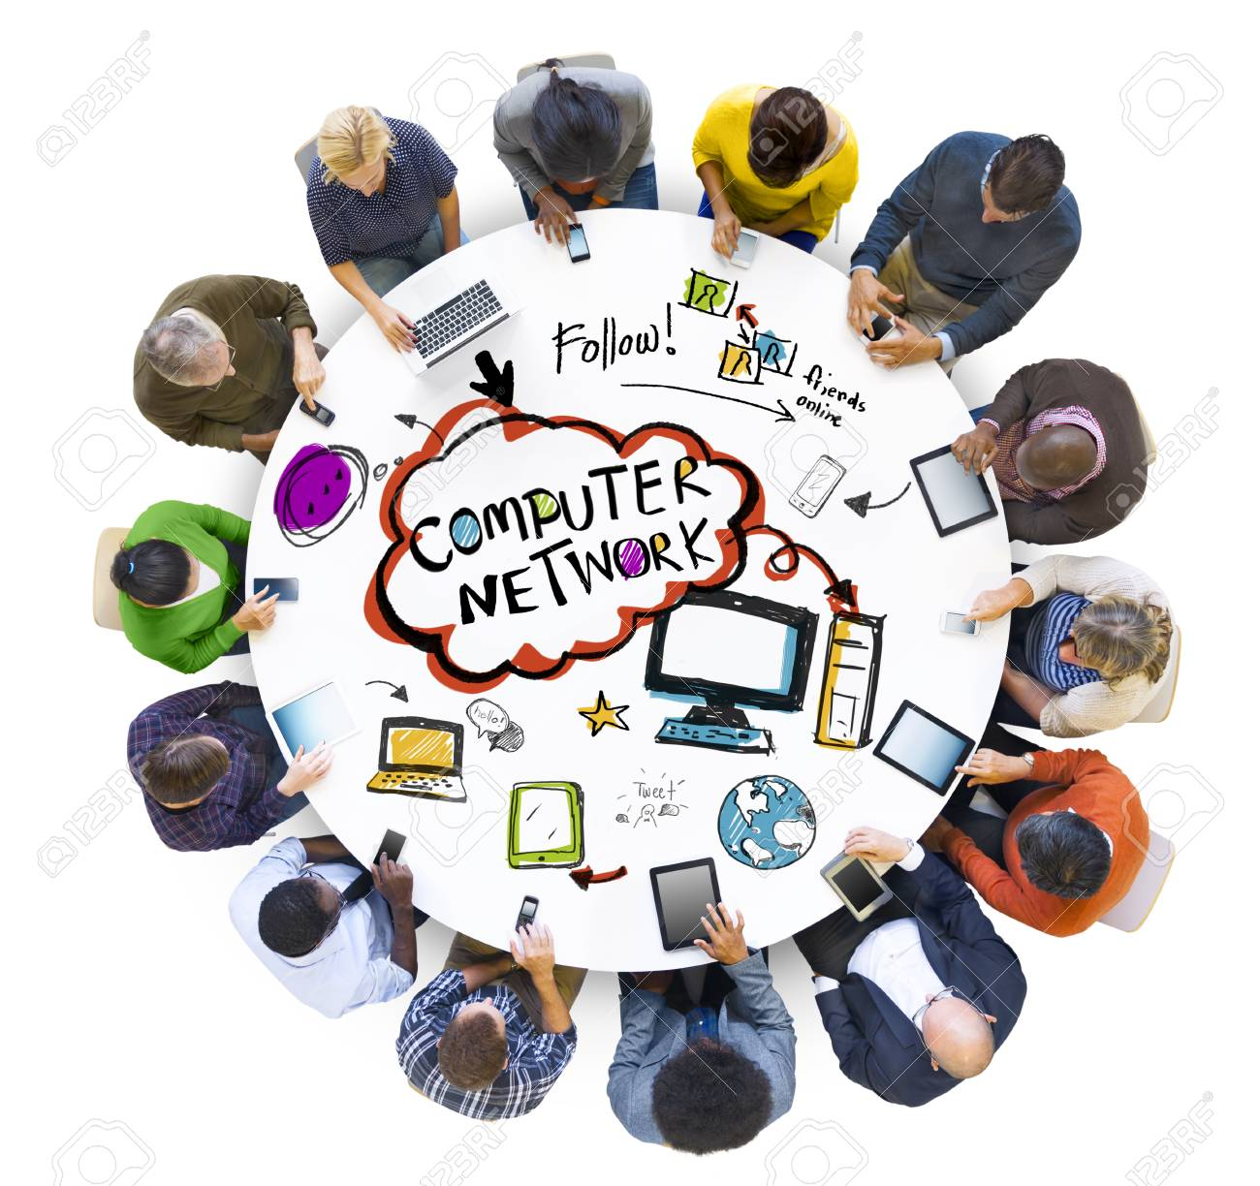
What is a network?
Set of technologies that connects computers or any other devices.
Allows communication and collaboration between users.

Slide 5
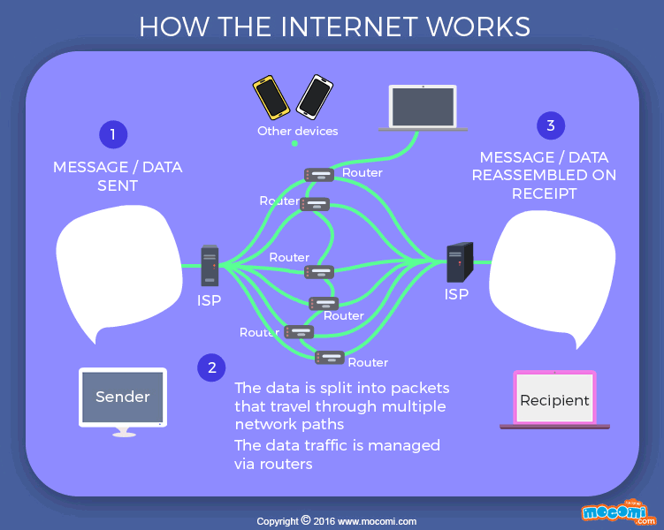
How does a network work?
Packets: Pieces of data transmitted over a network
Packets are created by sending node
Data is reassembled by receiving node

Slide 6
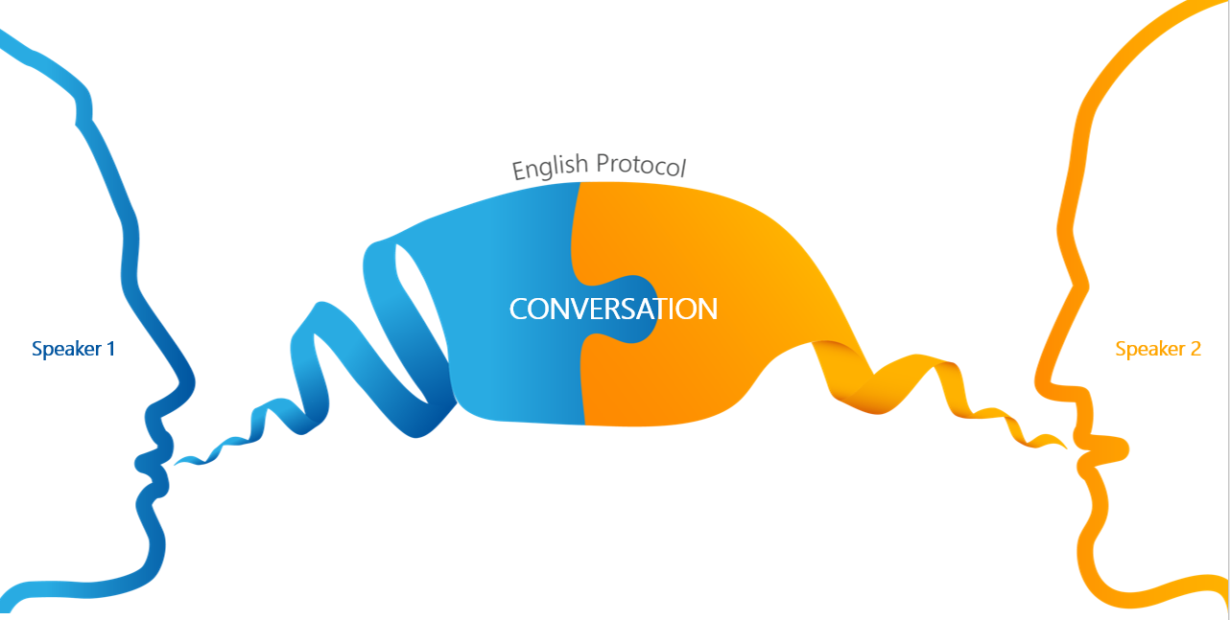
Protocol
Protocols are sets of rules.
What do you want to do? (Application)
Where are you going? (Addressing)
How do you get there? (Media types)
Did you get there? (Acknowledgments, Error checking)

Slide 7
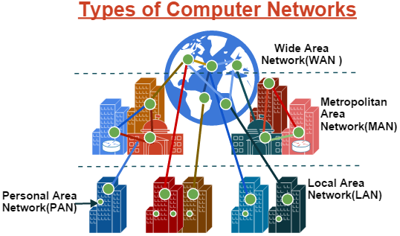
Network Types

Slide 8
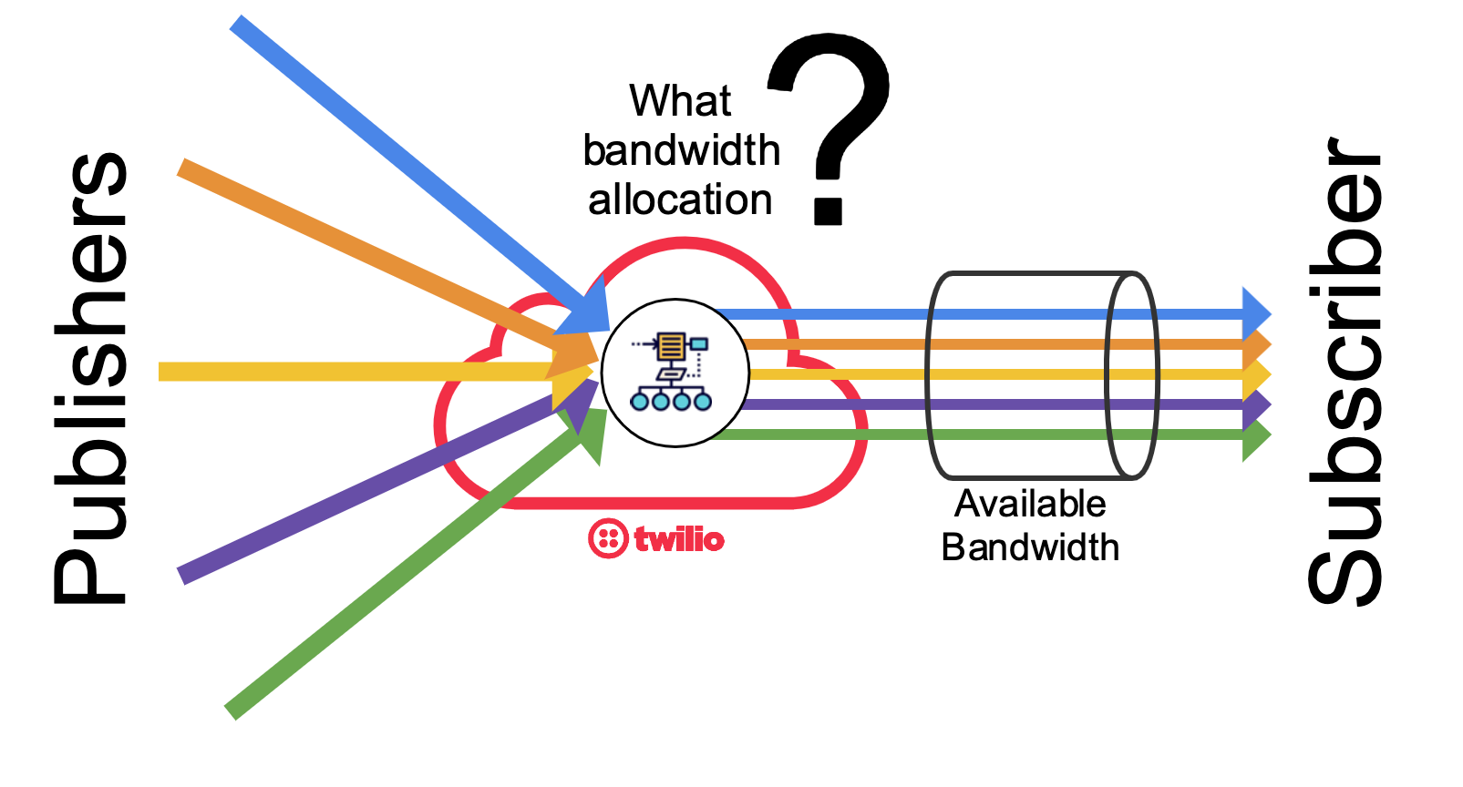
Network Attributes - Bandwidth
Bandwidth is the capacity at which a medium can carry data.
Bandwidth measures the amount of data that can flow from one place to another in each amount of time; how many bits can be transmitted in a second.

Slide 9
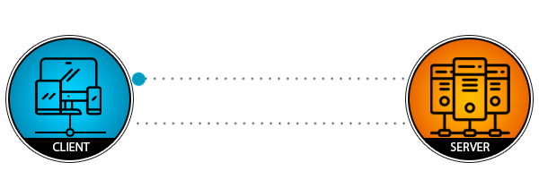
Network Attributes - Bandwidth
Latency: Amount of time, including delays, for data to travel from one given point to another.

Slide 10
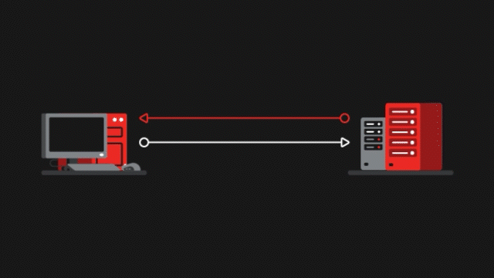
Network Attributes - Bandwidth
Jitter is a statistical variation of the delay in the delivery of data in a network, that is, it can be defined as the measure of the variation of the delay between successive packets of data.

Slide 11
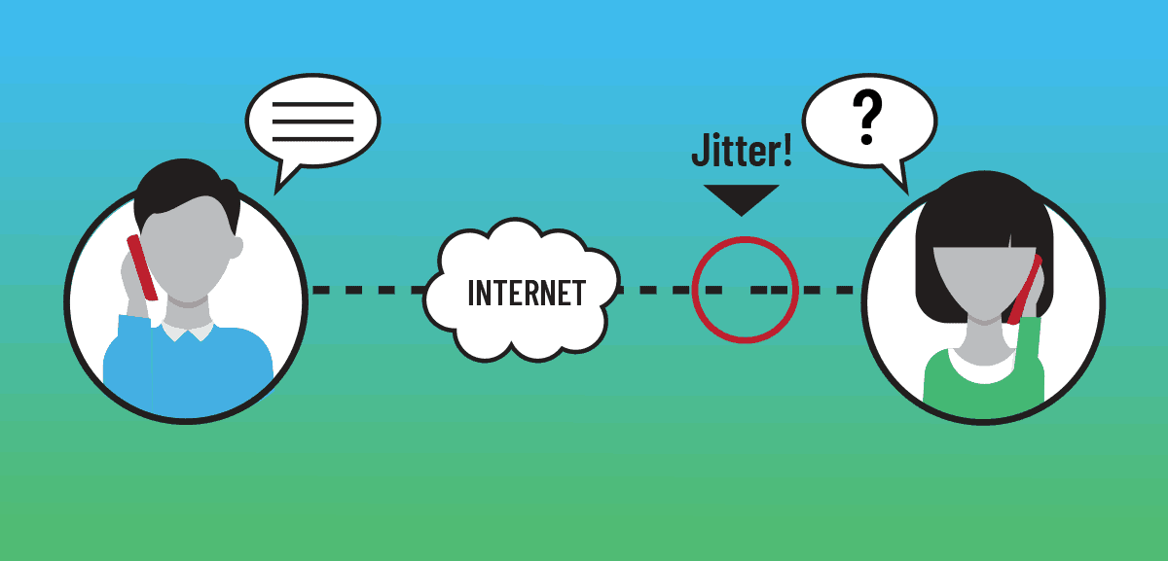
Network Attributes - Bandwidth
Jitter is a statistical variation of the delay in the delivery of data in a network, that is, it can be defined as the measure of the variation of the delay between successive packets of data.

Slide 12
Network Topology

Slide 13
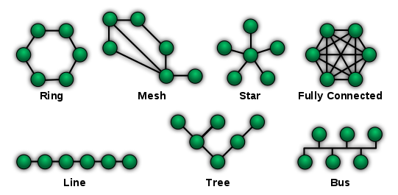
What is a Network Topology?
Logical layout of wires and equipment
Choice affects
Network performance
Network size
Network collision detection

Slide 14
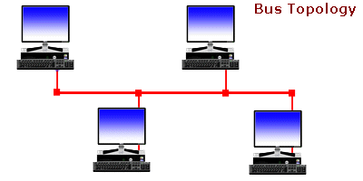
Bus Topology
One wire connects all nodes
Advantages: easy to setup; and small amount of wire
Disadvantages: slow; and easy to crash
Every node listen to all conversations in the channel
Elevated presence of collisions

Slide 15
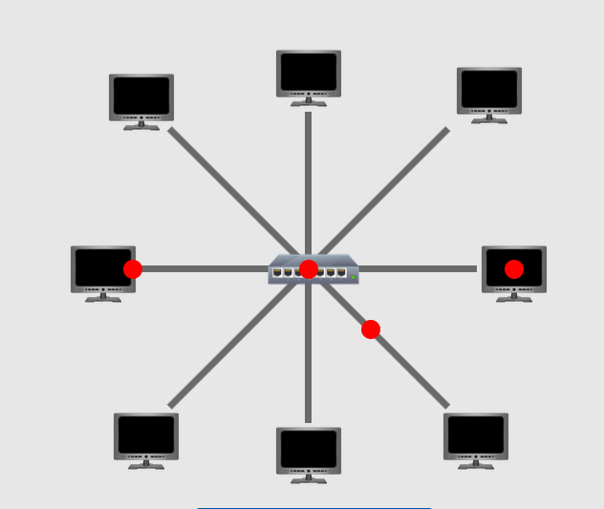
Star Topology
All nodes connect to a hub
Packets sent to hub
Hub sends packet to destination
Advantages: easy to setup; more resilience.
Disadvantages: One hub crashing downs entire network.
Most common topology

Slide 16
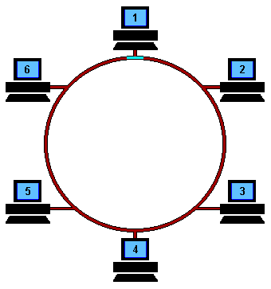
Ring Topology
Nodes connected in a circle
Tokens used to transmit data → nodes must wait for token to send
Advantages: Time to send data is known; and no data collisions.
Disadvantages: Slow.

Slide 17
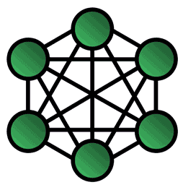
Mesh Topology
All computers connected together
Internet is a mesh network
Advantage: Data will always be delivered
Disadvantages: Hard to setup

Slide 18
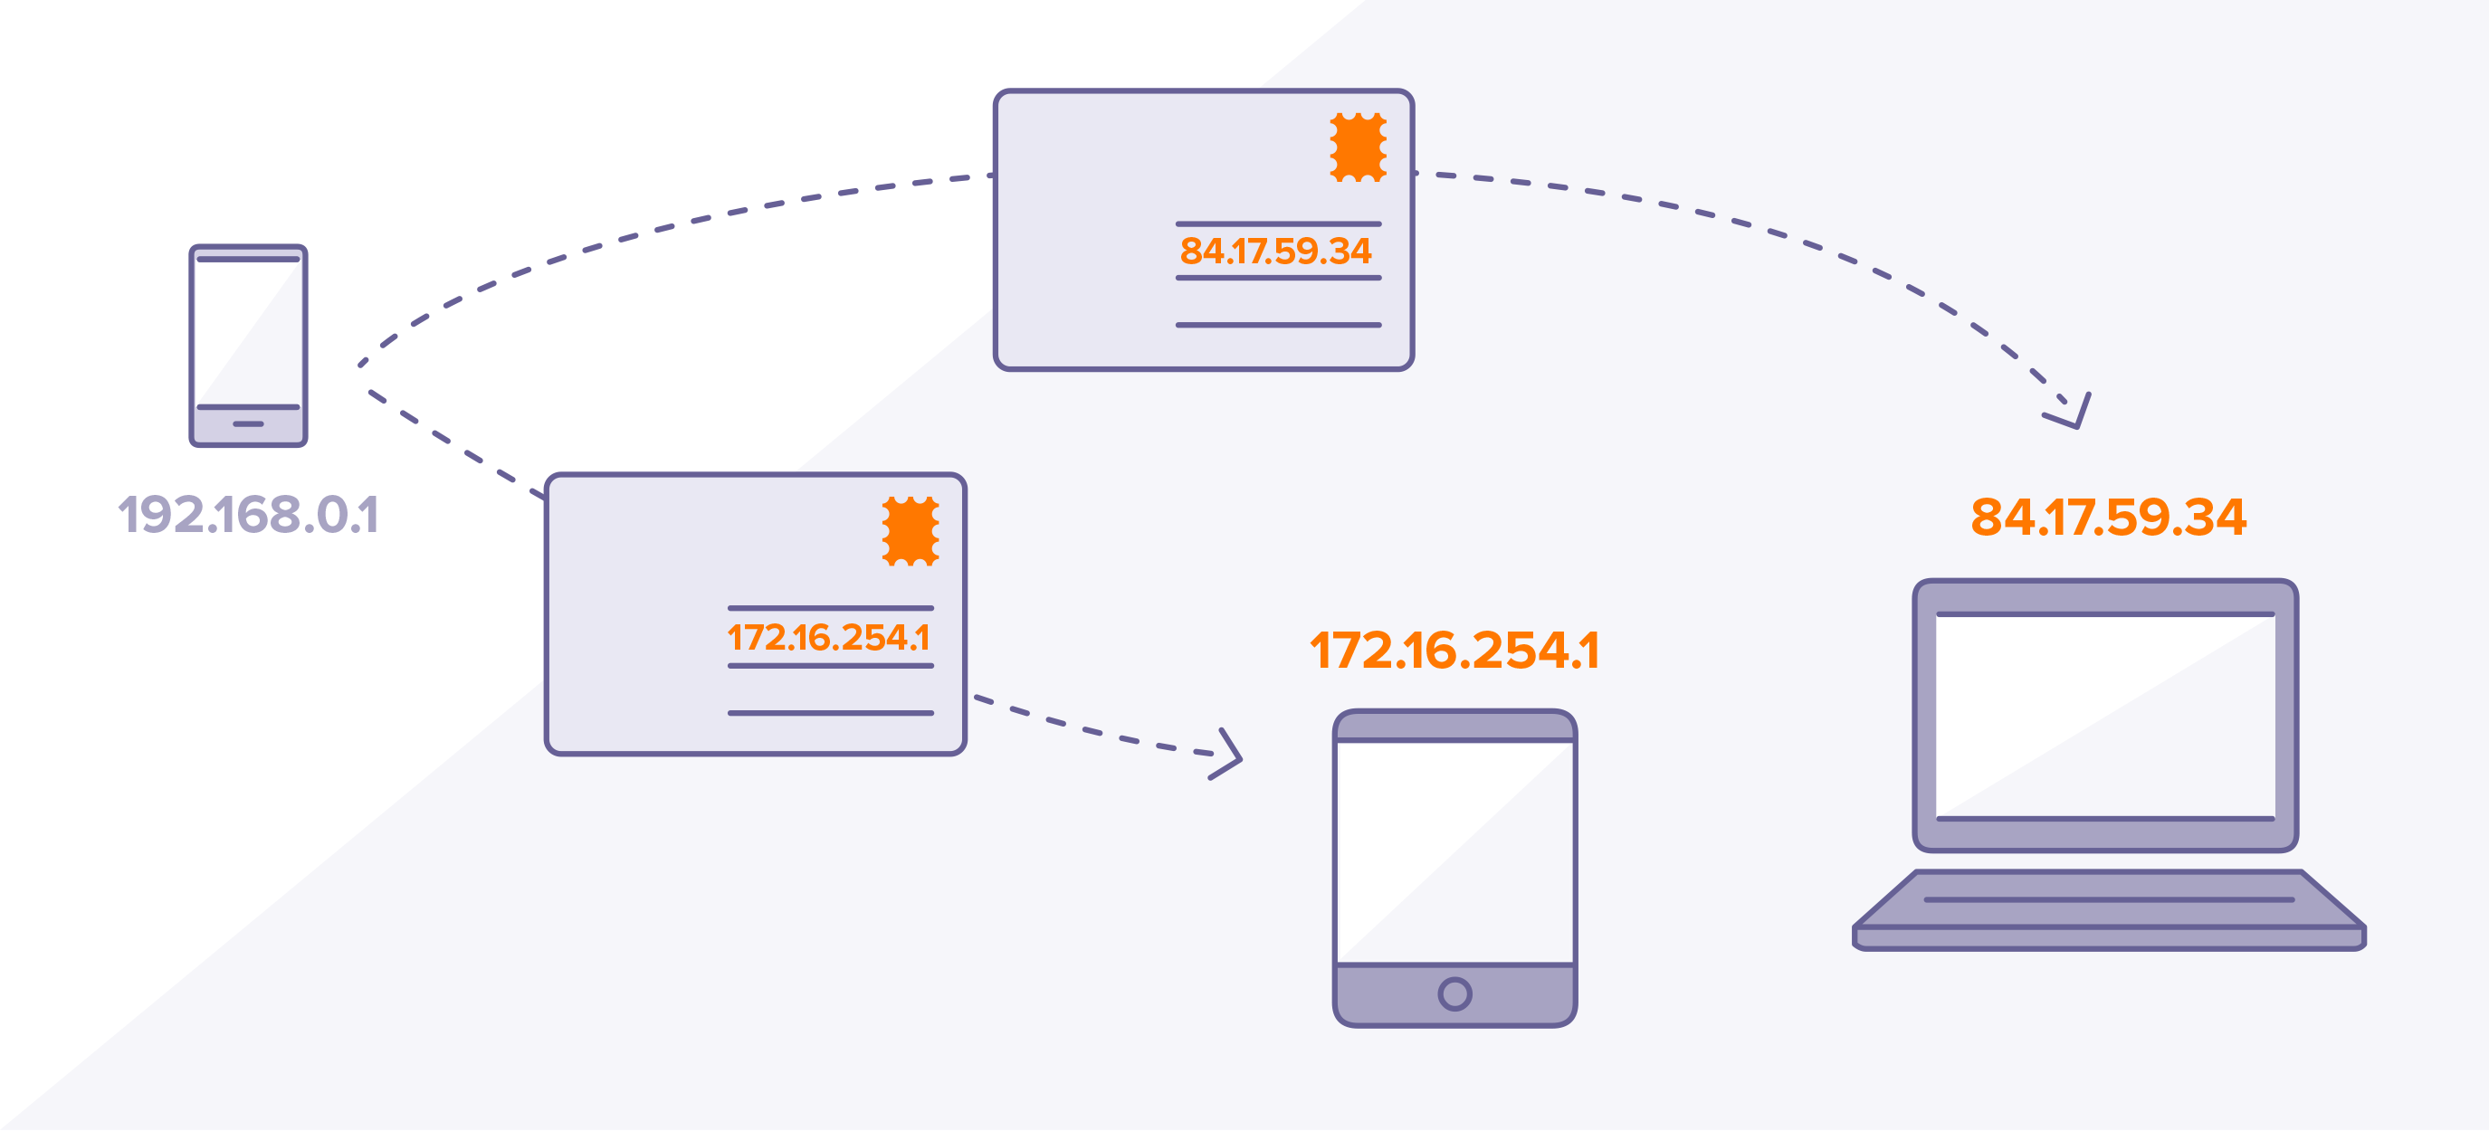
IP Address
An IP address is a unique address that identifies a device on the internet or a local network.
In essence, IP addresses are the identifier that allows information to be sent between devices on a network: they contain location information and make devices accessible for communication.

Slide 19
Network Media

Slide 20

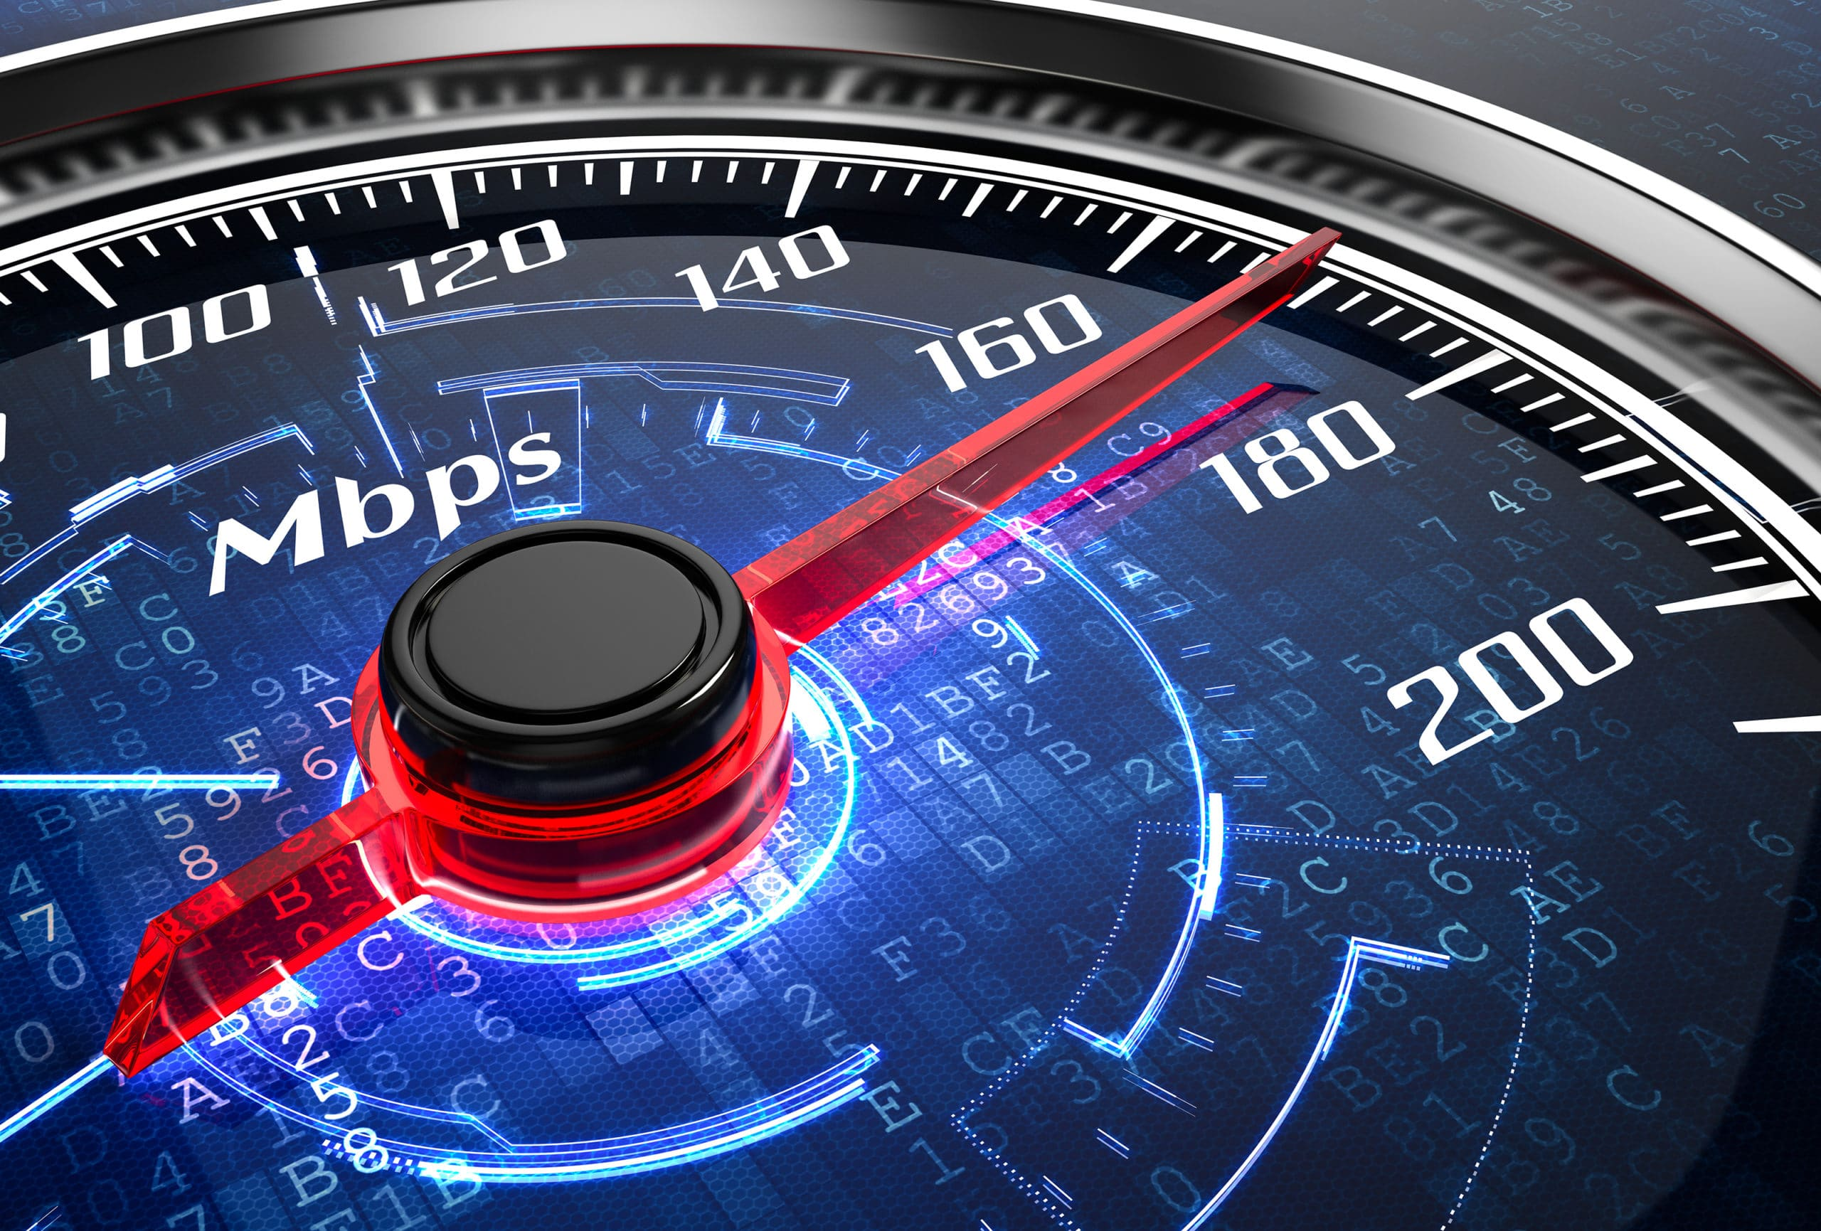

Network Media
Links that connect nodes
Speed
Defines
Security
Size

Slide 21
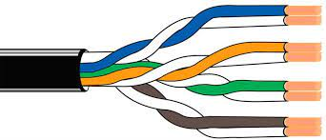
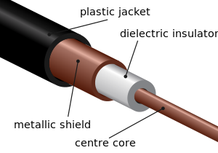
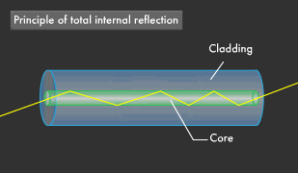

Wire Base Media (Twisted-Pair Cabling)
Wire Base Media (Coaxial Cabling)
Wire Base Media (Fiber-Optic Cabling)

Slide 22
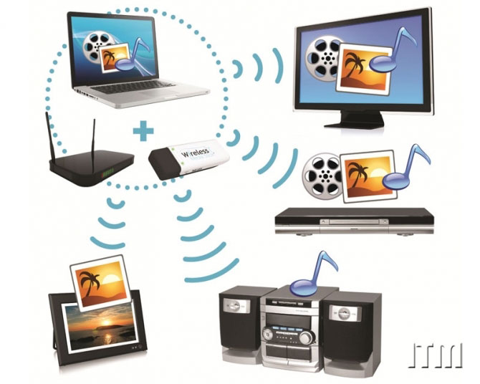
Wireless Media
Data transmitted through the air
LANs use radio waves
WANs use microwave signals
Easy to setup
Difficult to secure

Slide 23
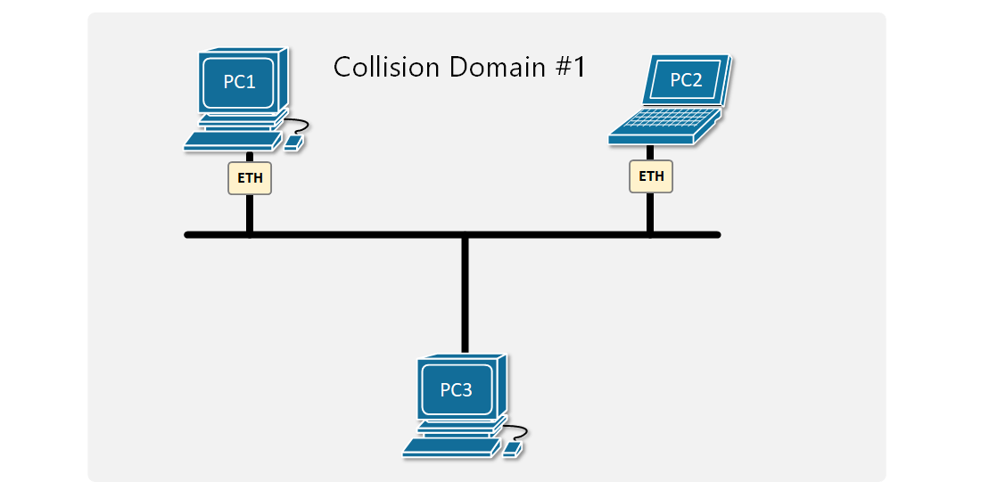
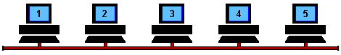
Collision
A collision domain is a network segment connected by a shared medium or through repeaters where simultaneous data transmissions collide with one another.
listen the channel, if available transmit
If a collision happened, launch a timer and wait

Slide 24
Wireless Sensor Networks

Slide 25
Wireless Sensor Networks (WSN)
Wireless sensor networks are made up of wirelessly connected smart objects.
Effective and well-coordinated communication and cooperation is a significant challenge, primarily because the sensors and actuators in WSN are diverse, heterogeneous, and resource-constrained.

Slide 26
WSN Limitations
Limited processing power
Limited memory
Lossy communication
Limited transmission speeds
Limited power

Slide 27
WSN Communication Patterns
Event-driven: Transmission of sensory information is triggered only when a smart object detects a particular event or predetermined threshold.
Periodic: Transmission of sensory information occurs only at periodic intervals.
The decision of which of these communication schemes is used depends greatly on the specific application
For example, medical use cases

Slide 28
WSN Communication Criteria

Slide 29
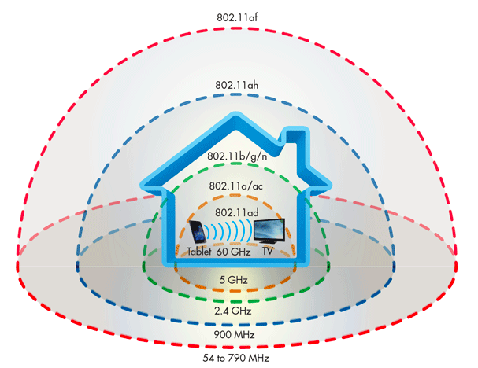
Range
How far does the signal need to be propagated?
That is, what will be the area of coverage for a selected wireless technology?
Should indoor versus outdoor deployments be differentiated?

Slide 30
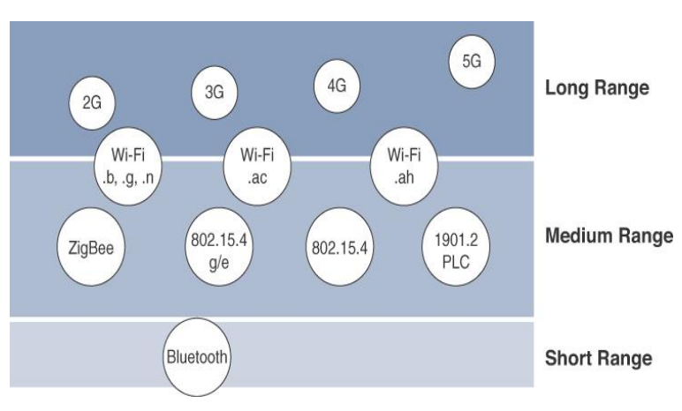
Range
tens of meters of maximum distance between two devices
IEEE 802.15.1 Bluetooth

Slide 31
Range
tens to hundreds of meters of maximum distance between two devices
IEEE 802.11 Wi-Fi
IEEE 802.15.4 (LR-WPAN): ZigBee, 6LoWPAN, etc.

Slide 32
Range
LPWA communications can communicate over a large area without consuming much power. These technologies are therefore ideal for battery-powered IoT sensors
Wireless (5G, 4G, LTE, etc.)
IEEE 802.11 Wi-fi
Low-Power Wide-Area (LPWA) technologies (SigFox, Lora, etc.).
Distances greater than 1 mile.

Slide 33
Frequency Bands
Radio spectrum is regulated by countries and/or organizations, such as the International Telecommunication Union (ITU) and the Federal Communications Commission (FCC).
For example, portions of the spectrum are allocated to types of telecommunications such as radio, television, military, and so on.
Frequency bands leveraged by wireless communications are split between licensed and unlicensed bands.

Slide 34
Frequency Bands
The ITU has also defined unlicensed spectrum for the industrial, scientific, and medical (ISM) portions of the radio bands.
Unlicensed means that no guarantees or protections are offered in the ISM bands for device communications.
ISM bands for IoT access
2.4 GHz band as used by IEEE 802.11b/g/n Wi-Fi
IEEE 802.15.1 Bluetooth
IEEE 802.15.

Slide 35
Power Consumption
A powered node has a direct connection to a power source, and communications are usually not limited by power consumption criteria.
Battery-powered nodes bring much more flexibility to IoT devices.
Battery-powered nodes are often placed in a “sleep mode” to preserve battery life when not transmitting.

Slide 36
Constrained-Node Networks
Constrained-node networks are often referred to as low-power and lossy networks (LLNs).
Low power: battery-powered constraints.
Lossy network: network performance may suffer from interference and variability due to harsh radio environments

Slide 37
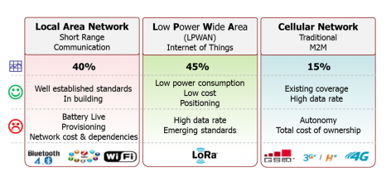

Slide 38
IoT Access Technologies

Slide 39
IoT Access Technologies
IEEE 802.11
IEEE 802.15.4
IEEE 802.15.4g and 802.15.4e
IEEE 1901.2a
LoRaWAN
NB-IoT and other LTE Variations

Slide 40

https://www.youtube.com/watch?v=hePLDVbULZc

Slide 41
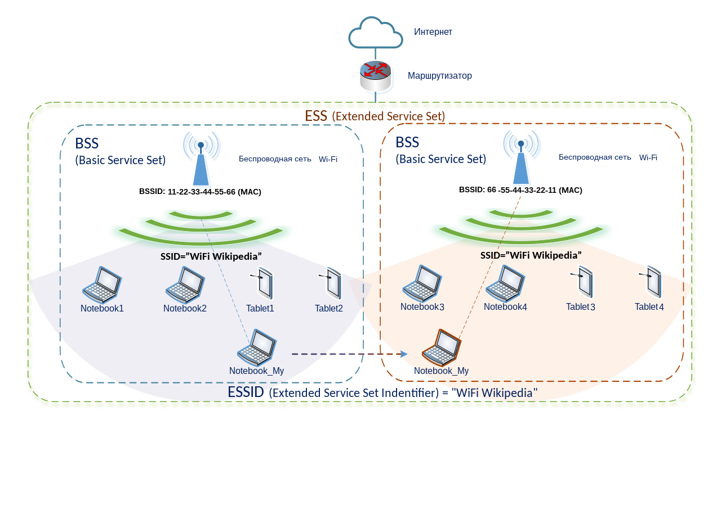
Wi-Fi

Slide 42
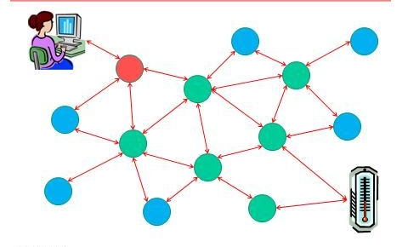
IEEE 802.15.4
Wireless access technology for low-cost and low-data-rate devices that are powered or run-on batteries.
This access technology enables easy installation while remaining both simple and flexible.
IEEE 802.15.4 is commonly found in the following types of deployments:
Home and building automation
Automotive networks
Industrial wireless sensor networks
Interactive toys and remote control
Mesh Network

Slide 43
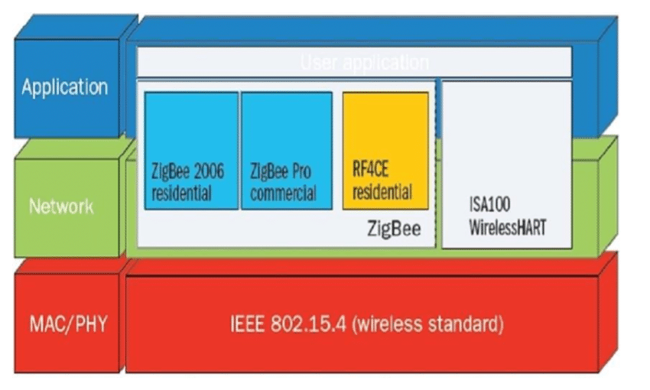
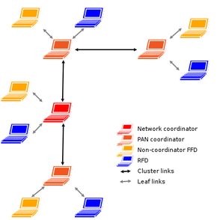
IEEE 802.15.4
ZigBee
6LoWPAN

Slide 44
IEEE 802.15.4g and 802.15.4e
The IEEE 802.15.4e expands 802.15.4, improving reliability, unbounded latency, and multipath fading.
IEEE 802.15.4e-2012 enhanced capabilities in the areas of frame format, security, determinism mechanism, and frequency hopping.
The focus of this specification is the smart grid or, more specifically, smart utility network communication.

Slide 45
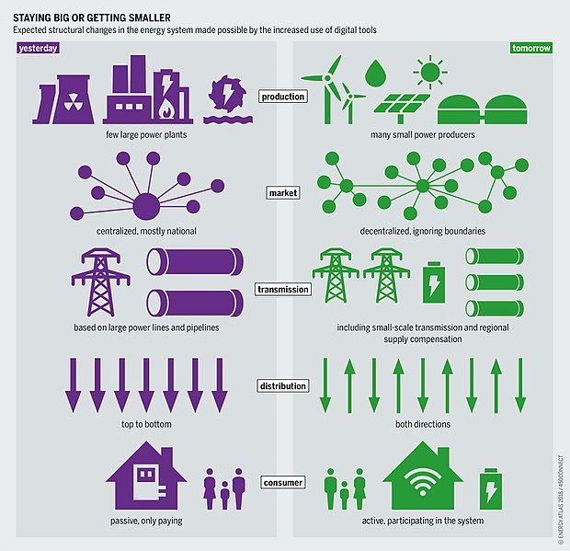
Smart Grid
The smart grid is a modern electrical grid that uses communication and information technology to collect information from the behavior of its customers. This is done so that it can automatically work itself to be more efficient and reliable in distributing electricity.

Slide 46
IEEE 1901.2a (Narrow-band Power Line Communication - NB-PLC)
Advanced Metering Infrastructure (AMI) is the foundation of the Smart Grid system. One of the most important parts of AMI is smart meter communication.
Power Line Communication (PLC) technology utilizes the existing power line network for communication media between smart meters and Data Collector Units (DCU).
Low reliability, limited throughput, lack of management, and poor compatibility affected the first generations of NB-PLC systems. As a result, many organizations have developed their own generation requirements.

Slide 47
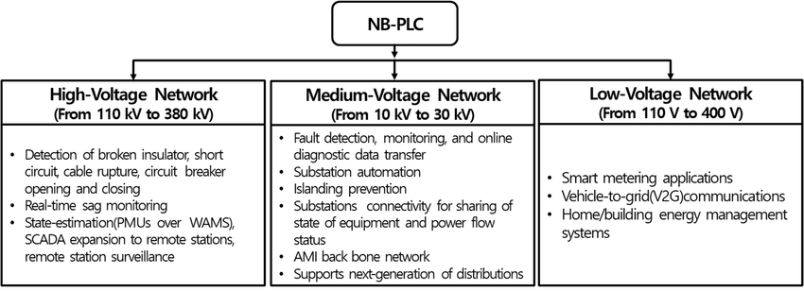
IEEE 1901.2a (Narrow-band Power Line Communication - NB-PLC)

Slide 48
LoRaWAN
LoRa is a radio frequency technology that allows communication over long distances (in urban areas 3-4 km range, and in rural areas, up to 12 km or more), with minimal power consumption.
LoRaWAN™ is the name given to the protocol that defines the system architecture as well as the communication parameters using LoRa® technology.
The LoRaWAN™ protocol implements the details of the operation, security, quality of service, and power settings to maximize module battery life, and application types on both the module and server sides.

Slide 49
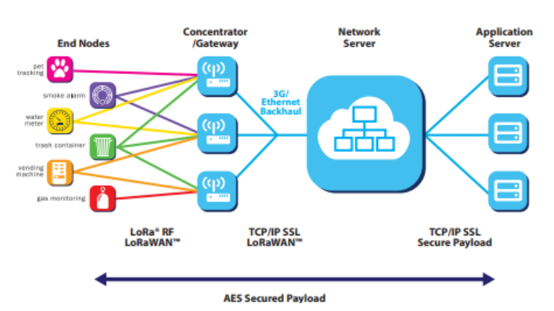

Slide 50
LTE
LTE stands for Long Term Evolution, and it was started as a project in 2004 by a telecommunication body known as the Third Generation Partnership Project (3GPP). LTE evolved from an earlier 3GPP system known as the Universal Mobile Telecommunication System (UMTS), which in turn evolved from the Global System for Mobile Communications (GSM).

Slide 51
LTE
LTE was introduced to get higher data rates, 300Mbps peak downlink and 75 Mbps peak uplink. In a 20MHz carrier, data rates beyond 300Mbps can be achieved under very good signal conditions.
LTE is an ideal technology to support high data rates for the services such as voice over IP (VOIP), streaming multimedia, videoconferencing, or even a high-speed cellular modem.
All interfaces between network nodes in LTE are now IP based, including the backhaul connection to the radio base stations.
Quality of Service (QoS) mechanisms have been standardized on all interfaces to ensure that the requirement of voice calls for a constant delay and bandwidth, can still be met when capacity limits are reached.
Works with GSM/EDGE/UMTS systems utilizing existing 2G and 3G spectrum and new spectrum. Supports handover and roaming to existing mobile networks.

Slide 52
NB-IoT
NB-IoT connectivity technology uses the same wireless spectrum as 4G LTE technology, but unlike this technology and other wireless telecommunications standards from previous generations, NB-IoT (along with LTE-M) is designed to provide good connectivity specifically for IoT technologies.
NB-IoT is conceptualized as an LPWAN (Low Power Wide Area Network) radio technology standard that allows a wide connection of devices and services through mobile networks, such as the 4G network.
It uses a licensed frequency spectrum where there is no interference with other devices, which ensures a much more stable data transfer.

Slide 53
NB-IoT
NB-IoT is generally used in IoT devices that do not need to transfer large amounts of data and do not require low latency.
In addition, it is a cheaper technology with a better response to fixed devices (sensors, for example).

Slide 54
LTE-M
The LTE-M network also uses frequencies licensed by telephone operators. In other words, telecom companies need not build new infrastructure to support the technology but only update software.
It is ideal for solutions that perform large data transfers.
LTE-M is used in applications that require more mobility, such as tractors in a field or devices to track vehicles because it has a range of 100 kilometers and a transmission rate of 1Mbps.
Like NB-IoT, the technology also has a long battery life and a low cost.

Slide 55
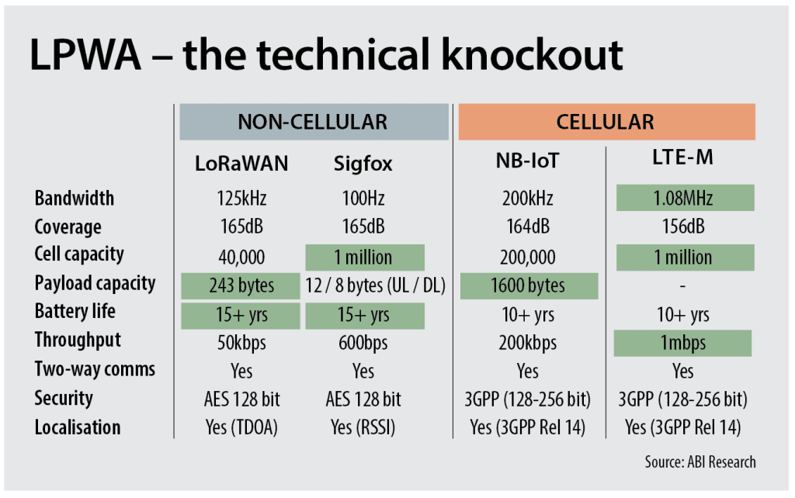

Slide 56
Unit 6.4 Introduction to means of access for IoT networks

